Slide 1
Early Stage Diabetes Risk Prediction
CSE 438
Department of Computer and Science
BRAC University
Dhaka, Bangladesh

Slide 2
Group Members
Group Members
FARAZ SIKDER SHAFIN
RITISHA ISLAM
MD MAHMUDUL HASAN
SHARTHAK DAS

Slide 3
Abstract
High blood sugar causes diabetes, a long-term condition.
Untreated diabetes affects several organs.
Disease prediction may save lives and help doctors treat patients.
The Random Forest Ensemble Method predicted diabetes best (98%).

Slide 4
Introduction
Diabetes causes heart disease, renal damage, and blindness.
The global diabetes population is rising.
Diabetes may be predicted using machine learning.
The machine learning system Random Forest predicts diabetes well.

Slide 5
Data Processing
Data preparation is essential in data mining for missing, noisy, or inconsistent data.
This analysis employed 17-attribute UCI diabetes data.
Some data mining methods handle discrete characteristics better.
This research tested key parameters using Chi-Square.

Slide 6
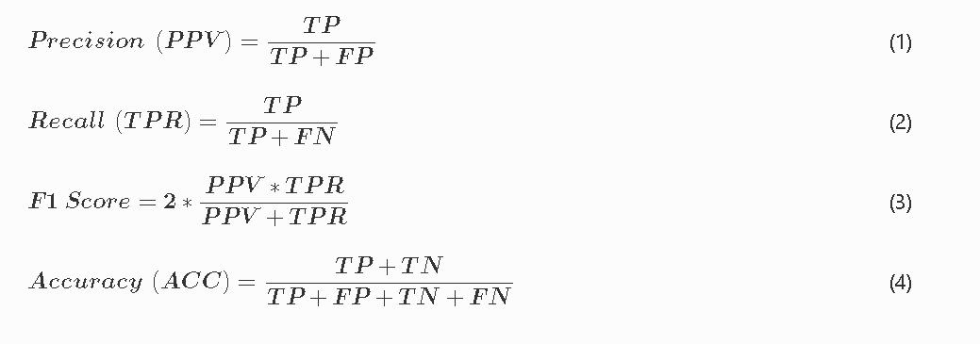
METHODOLOGY
Algorithms:
SVM
DECISION TREE
RANDOM FORESTS
NAIVE BAYES
KNN CLASSIFIERS
LOGISTIC REGRESSION

Slide 7
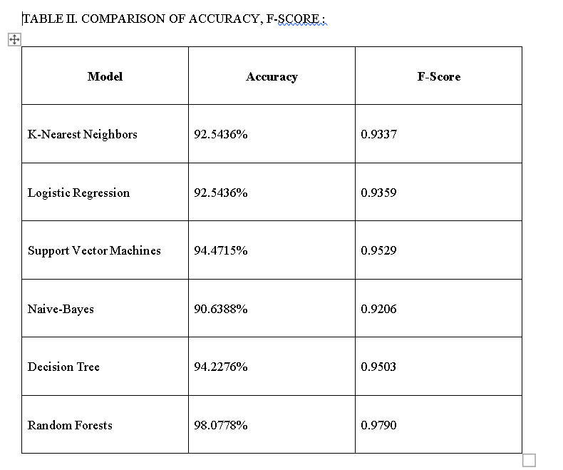
Discussion
Machine learning models can detect diabetes early.
The best diabetes prediction model is Random Forest Classifier with 98.0778% accuracy.
Multi-layer Perceptron and SVM also predict diabetes well.
Data is required to enhance diabetes prediction models.

Slide 8
Conclusion:
experimented with 7 classification algorithms on a diabetes dataset.
The results showed that Random Forest Classifier achieved the best performance, followed by Multi-layer Perceptron and Support Vector Machine.
Future studies collect more data from across the world and develop better algorithms for diabetes prediction.

Slide 9
ANY QUESTION?

Slide 10
THANK YOU

